Slide 1

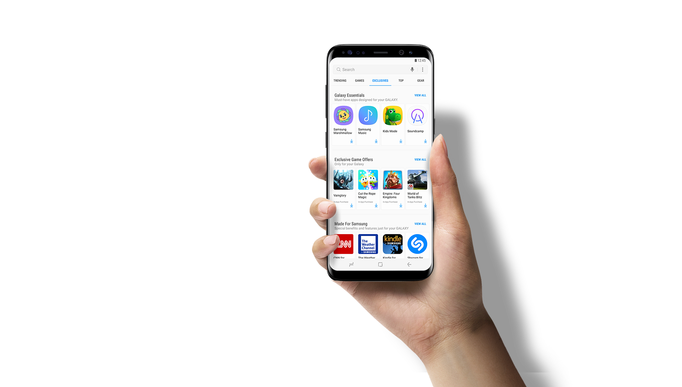

Drink Socially
A networking service for wine lovers
By Christophe CLEUET

Slide 2
Introduction
A mobile phone application designed to present as much information as possible on individual wines with professional assignment.
Allows its users to :
Rate wines
Share these check-in with friends
Get professional assessments and recommendations

Slide 3
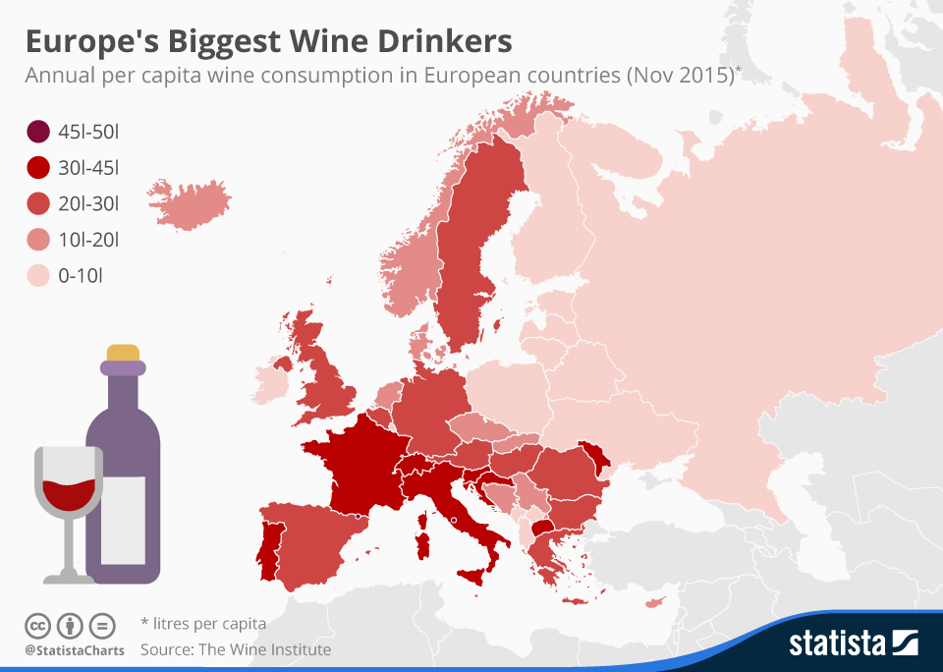
Nature of the Market
Wine is one of the most popular alcoholic beverages in Europe.
French consume about the same amount of wine as the whole population of the United States combined.
Number of potential French consumers : 17.4 millions.

Slide 4
Potential consumers
Non-targeted wine consumers :
Conservative wine drinkers want to buy wines they already like
Overwhelmed people won’t use the app. Do want not share their alcohol addiction on a social network.
Engaged newcomers do not take into account the occasion during which the wine will be drunk, when purchasing their wine, and they seek little information about their purchases.
Targeted wine consumers :
Image-seekers will search information and will believe more expensive wines are better quality.
Experimenter wine drinkers are keen to receive advice, like to try different wines.
Enthusiasts will seek some information before purchasing wine

Slide 5

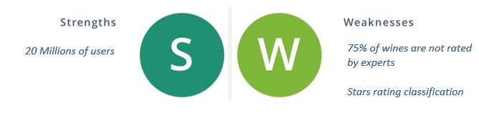

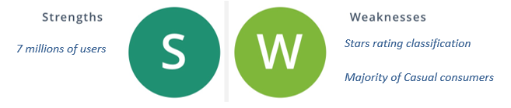
Main competitors
Mobile phone application that sells wine online and gives recommendations that adapt based on your tastes and preferences.
Mobile phone application that allows its users to rate beers and share these check-in with friends.

Slide 6
13 reasons why we are better (1)
Ratings system: One major problem existing with Vivino/Untappd ratings tends to occur on high-volume drinking days.
Drinking many different wines can make it very difficult to remain objective while deciding on how many stars it deserves.
Wine experts versus amateurs: Over 75% of wines in Vivino are never rated by wine experts.
Casual consumers: We don’t believe that the average ratings of a wine/beer will end up mattering very much to casual consumers.
--> Your friends’ or wine expert’s individual ratings will probably have much impact on your choices either.
How to improve stars rating classification: There are definitely ways to make a rating system that better fits user’s preferences. A few ideas could be:
A 1 to 5 scale for perceived hoppiness/bitterness
Individual rating areas for aroma, color, taste and mouthfeel
Develop a Chatbot to personalize customer experience and provide instant information to users

Slide 7
13 reasons why we are better (2)
Develop partnerships with producers and bars
Organize social events – Create a real community
Improve wine recommendation algorithm
Keep average rating secret until after your check-in
Add a guide on “How to test Wine”
Develop interaction between producers and customers
Add advices on “How to store your wines”
Create a blog and publish articles of wine influencers

Slide 8
Business Strategy
Free app for iOS, Android and Windows Phone.
--> We will earn money through promotions and advertisements
Strategy is based on the focus on a small number of wine consumers and to serve them better than anyone else.
Keys of success : convince customers of our brand's superior benefits
Strategic partnerships with wine bars, wine producers and professional oenologists
--> Partners will promote us to their customers and contacts
--> Our customers benefit from an expanded pool of trusted resources and it will strengthen our relationship with them

Slide 9
Generate advertising revenue with your application (1)
Revenue = Impressions * eCPM
Impressions - the number of impressions of an ad on the advertising platform.
eCPM - “Effective Cost per Mille.” -The advertising revenue generated per 1,000 impressions.
For an ad display to count as an impression, it has to be up for 30 seconds
Average Mobile eCPMs (2016)
iOS Banners | 0.20€ – 2.00€
iOS Interstitials | 3.00€ – 5.00€
Android Banners | 0.15€ – 1.50€
Android Interstitials | 2.00€ – 4.00€

Slide 10
Generate advertising revenue with your application (2)
We will suppose that our users will spend 3 minutes on the app per day with an average mobile effective cost per Mille of 2.5€.

Slide 11
Project Teams
Mobile application developers:
Design, build, test, implement and support the application.
Project Manager:
Actively seek sponsorships and promote the commercial benefits of our project.
Ensure that the project proceeds within the specified time frame and under the established budget
Sommelier:
make a professional assessment on wine

Slide 12
Aims & Objectives
Years | Users | Turnover | Profits
2018 | 10 000 | 41 062 € | 9 166 €
2019 | 45 000 | 184 781 € | 30 460 €
2020 | 75 000 | 307 968 € | 122 559 €
2021 | 100 000 | 410 625 € | 152 039 €
2022 | 125 000 | 513 281 € | 204 006 €

Slide 13
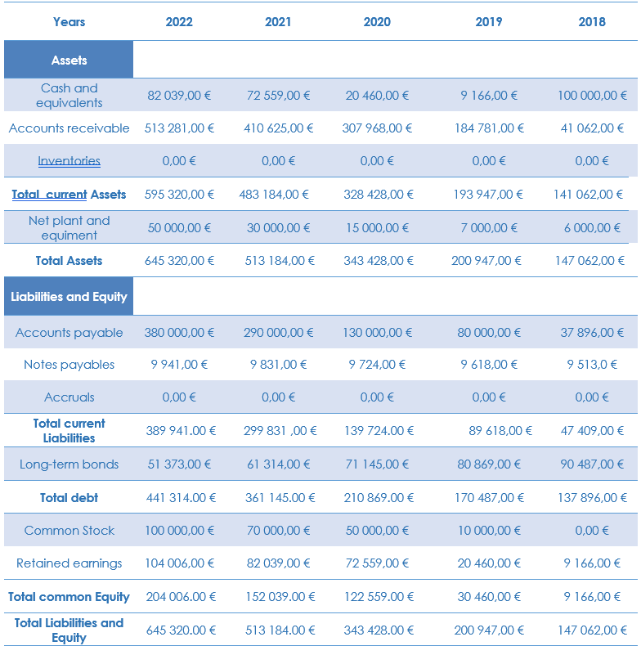
Balance sheet

Slide 14
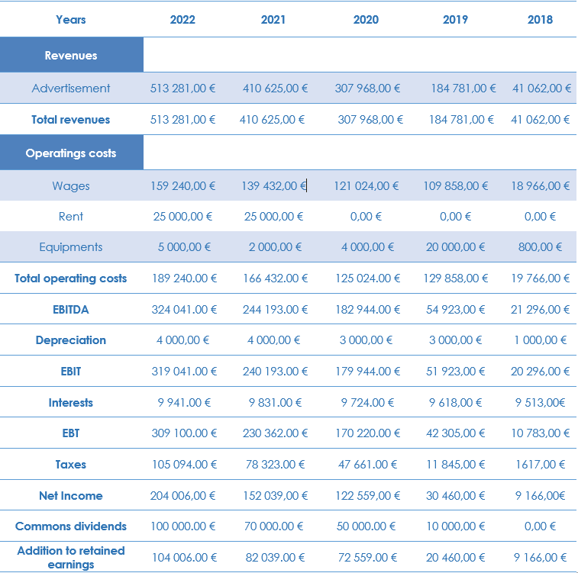
Income sheet

Slide 15
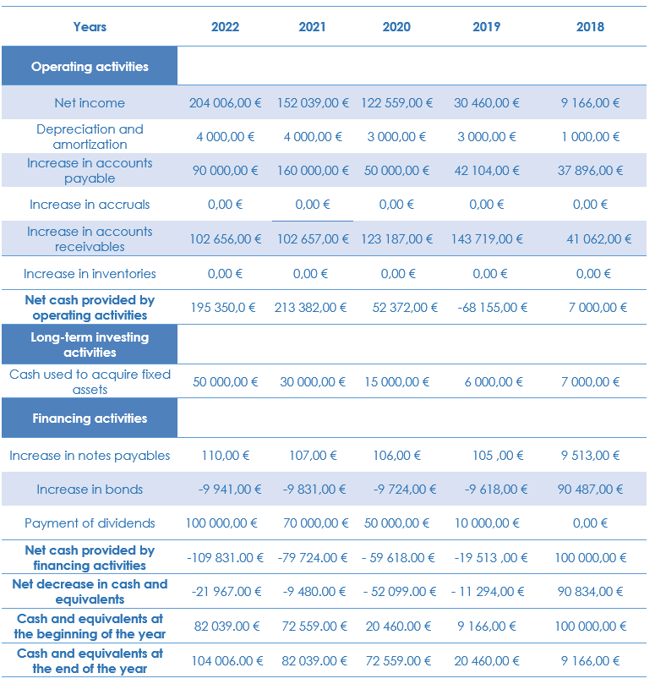
Cash flow

Slide 16
Financial gauges
Weighted Average Cost of Capital (WACC)
WACC = 7.9 %
Net Present Value (NPV) : used in capital budgeting to analyze the profitability of a projected investment or project.
NPV = 44 353 € > 0
Internal rate of return (IRR) : interest rate at which the net present value of all the cash flows from a project or investment equal zero
IRR= 33.193% > WACC

Slide 17
Financial needs
FUNDING REQUIREMENTS
To help our business and the growing of your company, we are seeking :
30,000 € investment in exchange for a 20% equity stake

Slide 18
Trivias and technical stuffs
The mobile application will be cross-platform : Android, iOS and Windows Phone
It will be developed in six months by a team of software engineers
The 2017 French corporate tax rate was 33.3%. In Czech Republic, it is 19%
Our office space will be based in a business incubator that helps new and startup companies to develop by providing services. Thus, we will not pay any rent for the three first years.

Slide 19
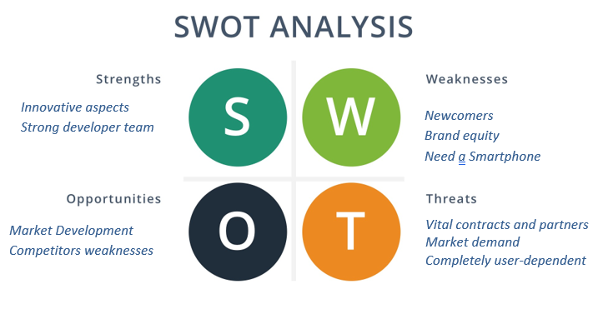

Slide 20

Questions ?

